Slide 1
PREDICTING CUSTOMER ACCEPTANCE OF NEW TERM DEPOSIT THROUGH TELEMARKETING
BY
DATA MINERS

Slide 2
TERM DEPOSITS
TELEMARKETING
Significant source of revenue
Money can be invested into higher return rate products
Money can be loaned out at higher interest rate
Lowers expenses
Increases profits
Focuses marketing profitable products
Targets customers most likely to buy

Slide 3
THE BUSINESS PROBLEM
Marketing campaigns involve significant costs and the success of the campaign is determined by how much money was spent on the campaign versus its profitability.
The labor hours involved in determining the customers most likely to open term deposits can be significantly reduced by evaluating a customer data set via data mining. This lower costs by allowing marketers to focus efforts on the most likely individuals to open term deposits with the bank.
Cost efficiency impacts all stakeholders, including customers, deposit-holders, and regulators. The bank is responsible for operating in a manner that preserves profits and delivers the most value to its customers.

Slide 4
This final project report encapsulates an in-depth study aimed at predicting customer acceptance of new term deposit offers through telemarketing campaigns by leveraging data mining techniques. The study was conducted by Team 2, Data Miners, at West Texas A&M University. At the heart of this investigation is a dataset from the UC Irvine Machine Learning repository, which records customer responses to term deposit offers via phone calls, along with extensive demographic and behavioral attributes. The dataset was meticulously prepared, ensuring quality and usability through the elimination of redundancies and outliers, and addressing missing values with careful consideration. Our objective is to use classification data mining techniques, including decision tree, Naive Bayes, logistic regression, and neural network, to create a product that will help banks save money and increase profits with their direct marketing campaigns by identifying the customers most likely to subscribe to a term deposit with the bank.
INTRODUCTION & OBJECTIVES

Slide 5

DATA ATTRIBUTES
16 Independent Variables
•Age of customer
•Type of job
•Marital status
•Highest education achieved
•Has credit in default?
•Average yearly bank balance
•Has housing loan?
•Has personal loan?
•Contact communication type?
•Last contact day of month?
•Last contact month of year?
•Last contact duration?
•Number of contacts performed during the campaign and for this customer.
•Was customer contacted after last campaign?
•Number of contacts performed before this campaign for this customer.
•Outcome of previous campaign?
Target Attribute
Did the customer subscribe to the term deposit? (Yes/No)

Slide 6
DATA DESCRIPTION
Gathering of information from various sources, ensuring completeness and accuracy.
The Bank Marketing dataset, curated by Paulo Cortez and Sérgio Moro in 2012, focuses on understanding consumer behavior and marketing strategies in the banking sector. It captures outcomes from direct marketing campaigns conducted by a Portuguese banking institution between May 2008 and November 2010. The dataset includes 45,211 records and provides insights into various demographic and behavioral attributes influencing clients’ subscription decisions. Attributes cover client characteristics (age, occupation, marital status, education), financial indicators (credit default status, average yearly balance, loan status), and marketing interactions (contact type, timing, duration). Previous campaign features, such as contact frequency and outcomes, help refine marketing strategies. The target variable ‘y’ indicates whether a client subscribed to a term deposit.

Slide 7
DATA PREPARATION
Outliers Detection: To identify outliers, we applied the three-sigma rule (68-95-99.7 rule). This rule considers that approximately 68% of data falls within one standard deviation of the mean, 95% within two standard deviations, and 99.7% within three standard deviations. Data points more than three standard deviations from the mean were flagged as outliers.
Numeric Variables: We examined seven numeric variables: Age, Balance, Day, Duration, Campaign, Pdays, and Previous. Notably, we retained all age data, viewing each age group as a significant market segment.
Balance Outliers: We removed 745 records with extreme balance values. Day Variable: For the "Day" variable (representing the day of the month when contact was made), we retained all records. Removing apparent outliers could distort the dataset by eliminating valid observations.
Duration, Campaign, Pdays, and Previous: We adjusted duration outliers by removing 964 records. Additionally, we removed 840, 1723, and 582 records for Campaign, Pdays, and Previous, respectively. The total number of records removed after cleaning was 4682.
Cleaning, organizing, and transforming raw data into a structured format suitable for analysis.
Missing Values: Although the dataset initially appears to have no missing values, further inspection revealed that certain variables (Job, Education, Poutcome, and Contact1) were labeled as "unknown," effectively representing missing data. We considered various techniques for handling these, including imputation and removal. Ultimately, we retained "unknown" as a separate category, recognizing its potential significance for telemarketing.

Slide 8
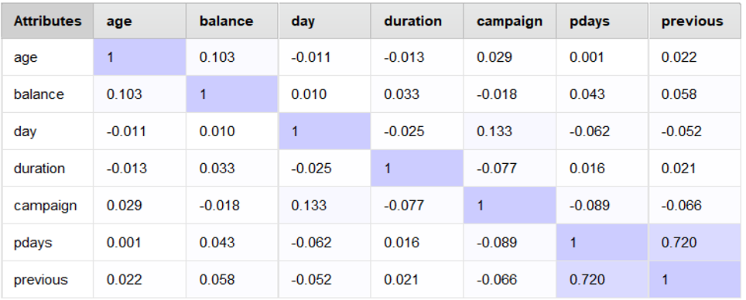
CONFUSION MATRIX
Our examination of the correlation matrix among numerical variables revealed no significant concerns, with the highest correlation coefficient being 72% between Previous(number of contacts performed before this campaign and for this client) and Pdays(number of days that passed by after the client was last contacted from a previous campaign). This was considered negligible, as our threshold for concern was set at 85%.

Slide 9
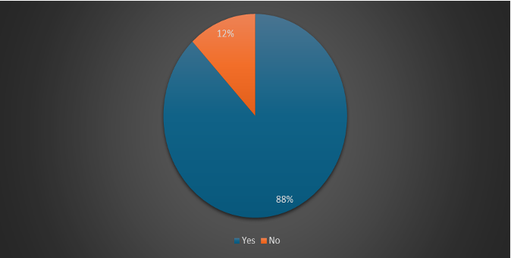
DATA PARTITIONING
For model training and testing, we used the holdout method, allocating 70% of the data (28,371 records) for training and the remaining 30% (12,158 records) for testing. The dataset exhibited an 88% 'Yes' (subscribed) to 12% 'No' (not subscribed) distribution, a balance maintained in both training and testing sets to ensure representativeness.

Slide 10
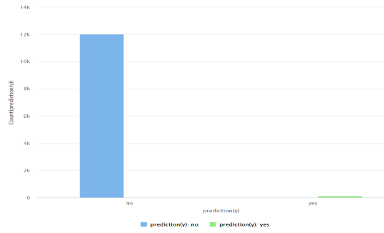
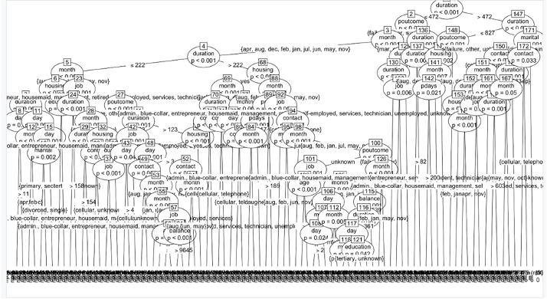
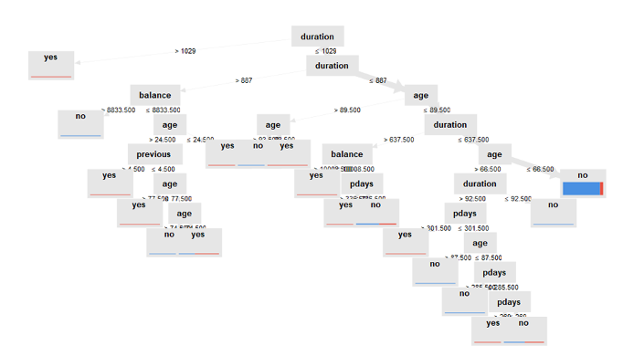
PREDICTIVE MODELING TECHNIQUES
DECISION TREE
Decision trees are a popular classification method that use a tree-like model of decisions and their possible consequences. They are easy to interpret and explain, mimicking human decision-making processes. Our decision tree models in both R and RapidMiner identified key attributes like call duration, customer age, account balance, and previous campaign interactions as significant predictors of term deposit subscription.

Slide 11
DECISION TREE
In RapidMiner, our decision tree predicts 12,019 instances of 'No' and 139 instances of 'Yes' for the subscription.
Key attributes identified by our decision tree in RapidMiner are:
• Duration: This is the most influential predictor. Longer call durations tend to increase the likelihood of subscription.
• Age: Specific age groups have distinct subscription behaviors, influencing the decision at various tree splits.
• Balance: Indicates financial stability, with higher balances often leading to subscription.
• Pdays: The time since the last campaign contact also affects the decision, with recent contacts being more significant.
• Previous: The number of prior contacts has a predictive value, influencing the likelihood of subscription.

Slide 12
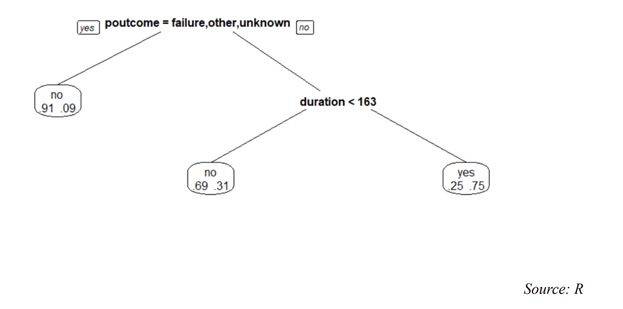
In R, our decision tree model results in 266 'Yes' and 11,892 'No' predictions for subscription. The 'Poutcome' variable, representing the outcome of the previous marketing campaign, emerges as the most significant predictor, suggesting that a positive experience with the bank increases the likelihood of a future subscription. The 'duration' of the call follows in importance, reinforcing the pattern seen in the RapidMiner model that longer interactions are more likely to result in positive outcomes.
In summary, both implementations highlight the significance of specific attributes in predicting subscription likelihood, with 'duration' consistently being a critical factor across both platforms.

Slide 13

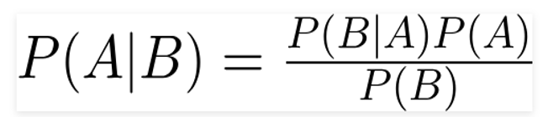
NAIVE BAYES
“Naïve Bayes is a probabilistic classifier based on applying Bayes' theorem with the “naïve” assumption of independence between every pair of features. Despite its simplicity, Naïve Bayes can yield surprisingly accurate predictions (Kumar, 2022). The model calculates the probability of each class and the conditional probability of each class given each input value.

Slide 14
NAIVE BAYES
In RapidMiner, our Naïve Bayes model predicts 10,471 instances of 'No' and 1,687 instances of 'Yes' for subscribing to the bank's term deposits. Similarly, in R, the model outputs 10,471 'No' and 1,687 'Yes' predictions. The attributes 'Duration' and 'Poutcome' appear to be particularly influential in both models. The notable differences in their means and standard deviations, or probabilities, across the two classes, suggest these variables are significant predictors in the context of term deposit subscriptions.

Slide 15
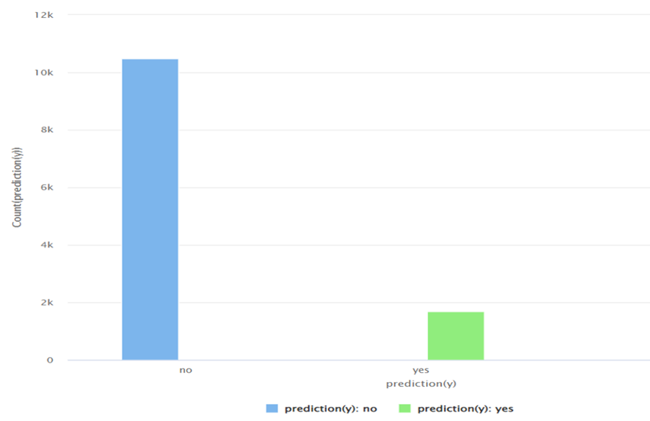
Conclusion drawn about the NB Model: The Naive Bayes Model would be a poor choice for the bank to use in this Data Mining effort. The model would lead the marketing team to spend more time in contacting customers that were less likely to purchase term deposits.
Poor performance is evident when presented graphically.

Slide 16
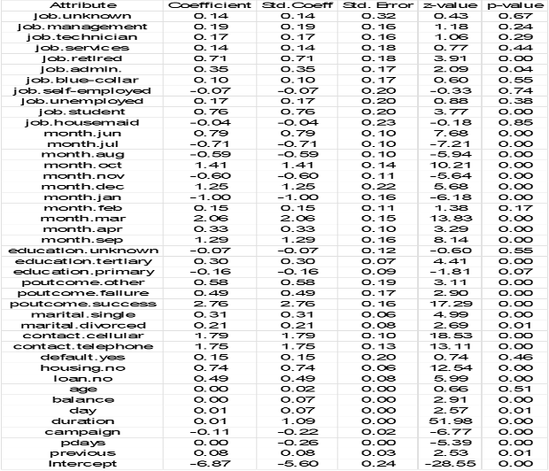
LOGISTIC REGRESSION
Logistic regression is a statistical model that applies a logistic function to model a binary dependent variable

Slide 17
LOGISTIC REGRESSION
Our logistic regression model in RapidMiner predicted 10,551 'No' and 1,607 'Yes' instances for subscription. Conversely, attributes like 'job.unknown', with a coefficient near zero and a high p-value, have less predictive significance
A higher proportion of people without a loan accepted the term deposit offer compared to those with a loan. The majority of respondents without a loan chose not to participate in the term deposit, while the acceptance rate was lower among those with a loan. This could be as a result of Loan repayment often seen as a more urgent financial goal and borrowers may prioritize reducing debt over saving.
In R, the logistic regression outputs are 1,687 'Yes' and 10,471 'No' predictions. The model identifies contact type, specific months, job categories, housing status, loan status, duration of 16 the last contact, and the outcome of the previous marketing campaign as significant predictors. For instance, having a housing loan (housing=yes) is associated with a negative impact on the probability of subscribing, while a successful outcome in the previous campaign (Poutcome=success) greatly increases the probability of a subscription.

Slide 18
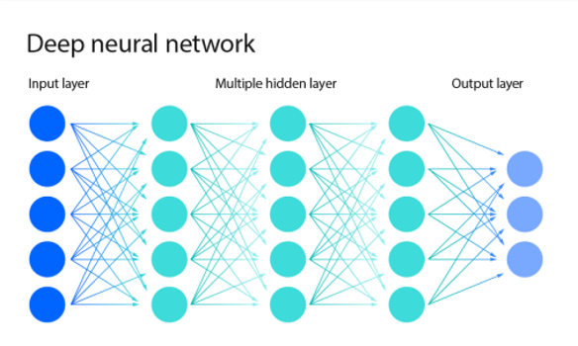
NEURAL
NETWORK
Neural networks are computational models inspired by the human brain's network of neurons. They consist of interconnected nodes or "neurons" arranged in layers (Zahner, 2000)

Slide 19
NEURAL NETWORK
In our RapidMiner implementation, the neural network model predicted 11,118 'No' and 1,040 'Yes' outcomes. The model’s complexity stems from its structure. In our case, it includes 52 inputs, corresponding to the different combinations of attributes and their possible values, particularly for nominal attributes, alongside the numeric attributes. This extensive input layer is necessary to capture the various factors that influence a customer's decision to subscribe to a term deposit.
Our network configuration comprises one hidden layer with 29 nodes. The number of nodes was chosen to balance the complexity of the model and the computational efficiency, allowing the network to learn the intricate patterns in the data without overfitting. These nodes, or neurons, in the hidden layer act as processors that weigh the input data, apply a transformation function, and pass the result to the next layer

Slide 20
The model culminates in two output nodes corresponding to the binary classification outcomes ('Yes' or 'No'). These outputs are determined by aggregating the weighted signals from the hidden layer, passing them through an activation function that dictates the final prediction. The weights between the nodes are adjusted during the training process to improve the model's accuracy in predicting whether a customer will subscribe to a term deposit
Understanding the exact reasoning behind each prediction in a neural network can be challenging due to its 'black box' nature, where the internal processing is not directly interpretable. However, the predictive performance of the model is often strong, making it a valuable tool in complex decision-making scenarios like customer behavior prediction.

Slide 21
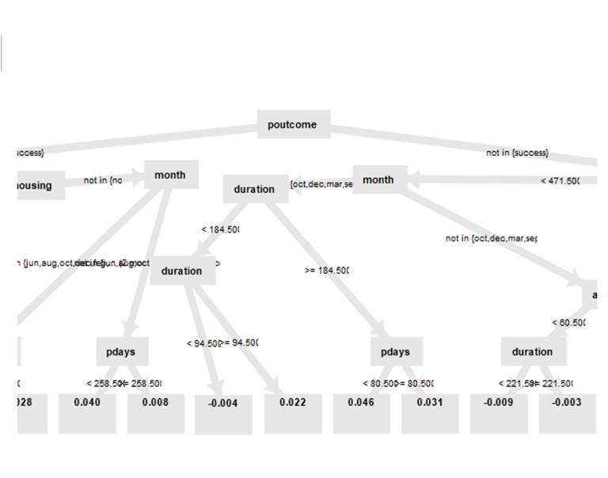
GRADIENT BOOSTING MACHINES (GBM)
GBMs iteratively improve predictions by combining the strengths of multiple decision trees. This approach helps in reducing bias and variance, leading to improved model performance on complex datasets.

Slide 22
GRADIENT BOOSTING MACHINE (GBM)
We opted to create a model consisting of 50 trees. This number was chosen to balance the tradeoff between model accuracy and the risk of overfitting. With too few trees, the model might not capture all the complexities of the data, whereas too many trees can lead to overfitting, where the model performs well on training data but poorly on unseen data. Each tree in the ensemble focuses on correcting the mistakes of the previous one, gradually improving the overall model's accuracy. By limiting the number to 50, we ensure that the model remains general enough to perform well on both the training and unseen test data, while still being sufficiently detailed to capture the underlying patterns in customer behavior regarding term deposit subscriptions

Slide 23
MODEL EVALUATION & PERFORMANCE
Accuracy, Precision, Recall &
F-measure
Top Performing Models
Deployment Strategies
We evaluated the models based on key performance metrics, including accuracy, precision, recall, and the F-measure. These metrics provided insights into the models' ability to correctly identify subscribers, minimize marketing costs, and strike a balance between the two.
The Logistic Regression model in RapidMiner and the Decision Trees model in R emerged as the top performers, demonstrating strong predictive power and offering valuable insights into customer behavior.
Deployment strategies involve integrating the models into the bank's current systems, continuously monitoring their performance, and regularly updating them to adapt to changing customer patterns.

Slide 24
LIMITATIONS & CHALLENGES
Interpretability of Complex Models
The 'black box' nature of models like Neural Networks makes it challenging to derive actionable insights on why certain predictions are made, which can hinder trust and acceptance among end-users.
03
Static Historical Data
The reliance on a historical dataset may not fully capture the dynamic nature of customer behavior, and the models may not account for unforeseen economic or social changes that affect customer decisions.
01
02
Ethical Considerations
The examination of the ethical implications of data mining, particularly in terms of privacy and consent, is imperative in ensuring that these advancements are aligned with broader social values and norms.

Slide 25
INSIGHTS & IMPLICATIONS
Leveraging Data Mining: The study underscores the transformative potential of data mining in the banking sector's marketing strategies, offering a strategic edge in an intensely competitive market.
Enhancing Customer Targeting: The models' insights into customer behavior enhance the bank's ability to target potential subscribers efficiently, maximizing marketing ROI and reducing associated costs.
Future Research Directions: Future research directions include real-time data analysis and the exploration of hybrid models for enhanced predictive accuracy and interpretability, as well as discussions on the ethical implications of data mining in maintaining customer trust and privacy.

Slide 26
CONCLUSION
Data Driven Approach
Customer Insights
Ethical Considerations
The study underscores the transformative potential of data mining in the banking sectors marketing strategies, providing a strategic edge in an intensely competitive market
The predictive model offer valuable insights into customer behavior, enhancing the banks ability to target potential subscribers efficiently and maximize marketing ROI
The study opens up critical discussions on the ethical implications of data mining, ensuring the bank maintains customer trust and privacy while leveraging these powerful analytical tools

Slide 27


THANK
YOU
Chidinma Aniekwena
Chukwuebuka Dibie
Fougnigue Sefon
Mariam Adegbindin
Tokoni Forun

